Slide 1


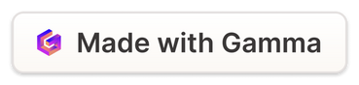
AI-Powered Content Moderation to Combat Toxicity
This presentation explores the use of Artificial Intelligence (AI) and Natural Language Processing (NLP) to detect and combat toxicity in online comments, aiming to create a safer and more inclusive online experience.
Presented by
Anukrati Vaishnav
MITA
AV
Notes:
1

Slide 2



The Problem of Online Toxicity
Harassment and Abuse
Spread of Misinformation
Mental Health Impact
Toxic comments can create hostile environments and discourage participation, particularly for marginalized groups.
Toxic content can spread misinformation and harmful narratives, impacting public discourse and decision-making.
Exposure to toxicity can contribute to anxiety, stress, and depression for users, particularly those who are vulnerable.
Notes:
2

Slide 3

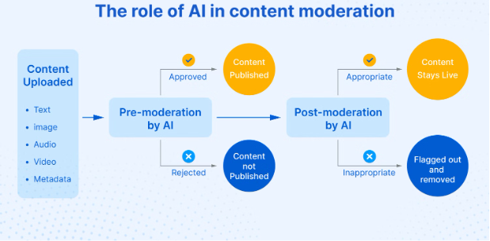
Project Objectives
1
Develop a Business Case
2
Automated Moderation
Investigate the feasibility of deploying a machine learning model to detect toxicity in the business world.
Create a data-driven justification for deploying automated content moderation.
3
Provide Actionable Insights
Offer data-driven insights on toxicity trends, comment characteristics, and user behavior.
Notes:
4

Slide 4

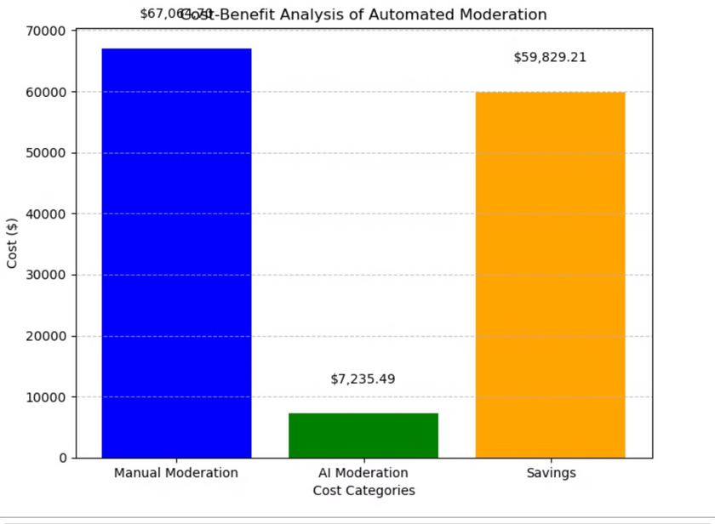
Project Deliverables
Cost-Benefit Analysis
Predictive Model and its performance
Compare the costs of manual versus automated moderation.
Outline the steps for deploying an AI-powered content moderation solution.
Risk Assessment
Analyze potential false positives and negatives in automated moderation.
Notes:
5

Slide 5
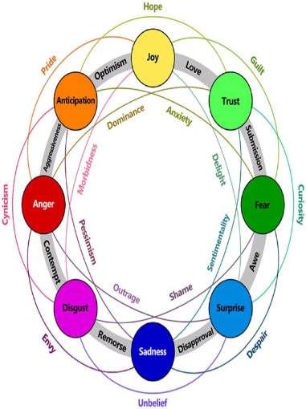
Data Preprocessing &
Feature Engineering
Data Set
Used a pre-labeled dataset from Kaggle. The dataset consists of 223,550 comments annotated with subtypes of toxicity.
Data Cleaning
Handled missing values, removed non-text elements, and preprocessed the data for model training.
Feature Extraction
Extracted features like comment length, word count, and sentiment scores to enhance the model's understanding of toxicity.
Notes:
6

Slide 6





Machine Learning Models
Semi-Supervised Learning
LSTM
Used Long Short-Term Memory networks to capture sequential patterns in text data.
Leveraged both labeled and unlabeled data for model training.
CNN
BERT
Employed Convolutional Neural Networks to identify patterns and features in text data.
Utilized Bidirectional Encoder Representations from Transformers, a powerful language model for understanding text.
Notes:
7

Slide 7
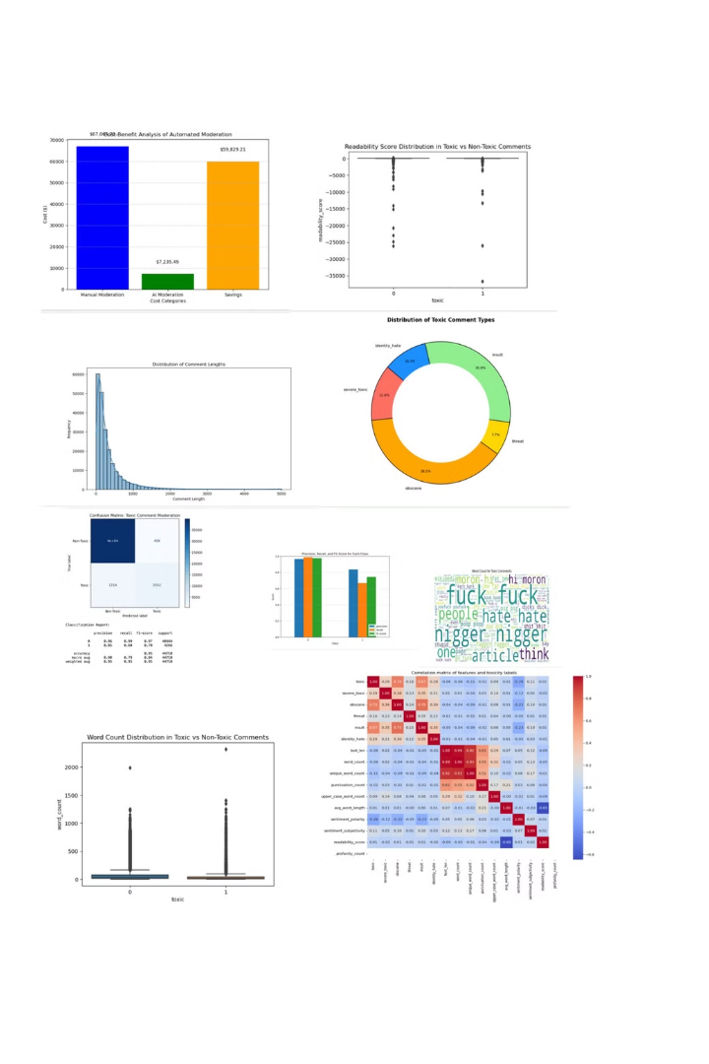
Model Performance Evaluation
~96%
~84%
Accuracy
Precision
Proportion of correctly classified comments.
Proportion of true positive predictions among all positive predictions.
~67%
~74%
Recall
F1-Score
Proportion of true positive predictions among all actual positive instances.
The harmonic mean of precision and recall, providing a balanced measure of model performance.
Notes:
8

Slide 8
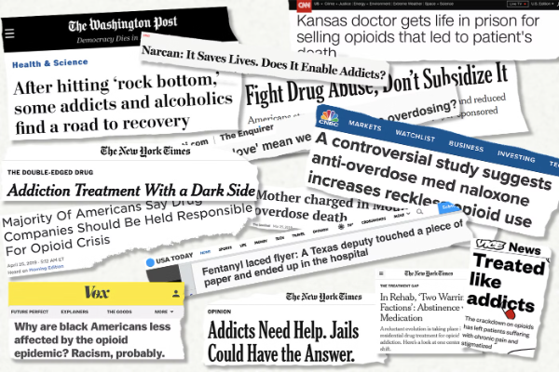
Toxicity Analysis
in the Dataset
Prevalence
10.05% of comments were flagged as toxic.
Insights
Toxic comments exhibit higher word counts and stronger negative sentiment.
Characteristics
High frequency of offensive words in flagged content.
Notes:
9

Slide 9

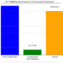
Automated Moderation with AI
Proposed Solution
Benefits
Implement an AI-powered moderation system using LSTM and BERT models.
Achieve cost efficiency, scalability, and speed in content moderation.
Notes:
10

Slide 10






Cost-Benefit Analysis
Annual Savings
AI Solution Cost
Manual Moderation Cost
Notes:
11

Slide 11
Risk Assessment
Risk
Impact
Mitigation
False Positives
Flagging non-toxic content
Allow human review for edge cases.
False Negatives
Missing toxic content
Continuous model improvement.
Bias in AI
Unfair content flagging
Use diverse datasets for training.
Implementation Costs
High initial cost
Gradual rollout with performance review.
Notes:
12

Slide 12
Conclusion
AI-Powered Moderation reduces costs by ~92% annually compared to manual moderation.
Ensures scalability, speed, and consistency in toxicity detection.
Implementing this solution can enhance user experience and protect brand reputation.
1
2
3
Notes:
13

Slide 13
Next Steps
Approval of Project Budget: Finalize funding for AI model(BERT/LSTM) development.
Pilot Deployment: Test automated moderation on a small dataset.
Performance Review: Monitor false positives/negatives and fine-tune the model.
Notes:
14

Slide 14
Questions?
Notes:
15

Slide 15
Thank you!
Notes:
16

